Slide 1
Binomial Series

Slide 2
Binomial Series
Before presenting the basic list for elementary functions, you will develop one more series—for a function of the form f(x) = (1 + x)^{k}. This produces the binomial series.

Slide 3
Example 4 – Binomial Series
Find the Maclaurin series for f(x) = (1 + x)^{k} and determine its radius of convergence.
Assume that k is not a positive integer and k ≠ 0.
Solution:
By successive differentiation, you have
f(x) = (1 + x)^{k} f(0) = 1
f'(x) = k(1 + x)^{k – 1} f'(0) = k
f''(x) = k(k – 1)(1 + x)^{k – 2} f''(0) = k(k – 1)
f'''(x) = k(k – 1)(k – 2)(1 + x)^{k – 3} f'''(0) = k(k – 1)(k – 2)
. .
. .
. .
f ^{(n)}(x) = k…(k – n + 1)(1 + x)^{k – n} f ^{(n)}(0) = k(k – 1)…(k – n + 1)

Slide 4
Example 4 – Binomial Series
cont’d
which produces the series
Because a_{n + 1}/a_{n}→1, you can apply the Ratio Test to conclude that the radius of convergence is R = 1.
So, the series converges to some function in the interval (–1, 1).

Slide 5
Deriving Taylor Series from a Basic List

Slide 6
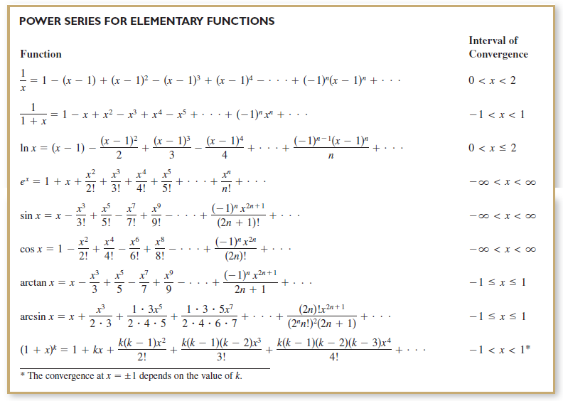
Deriving Taylor Series from a Basic List

Slide 7
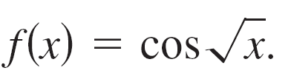



Example 6 – Deriving a Power Series from a Basic List
Find the power series for
Solution:
Using the power series
you can replace x by to obtain the series
This series converges for all x in the domain of —that is, for x ≥ 0.

